Slide 1
Programmable Logic Controllers (PLCs)
Dr. Noureddine Bekhouche
Dept. of Applied Engineering

Slide 2
Definition
A PLC is a digital computer designed for use in machine control.
Designed to operate in the industrial environment.
Equipped with special input/output interfaces and a control programming language.
PC (Programmable Controller): Original Acronym

Slide 3
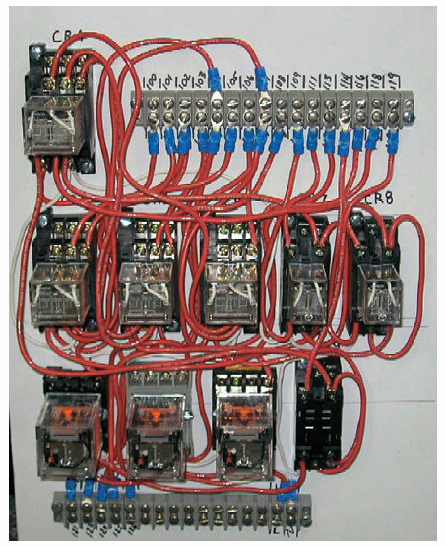
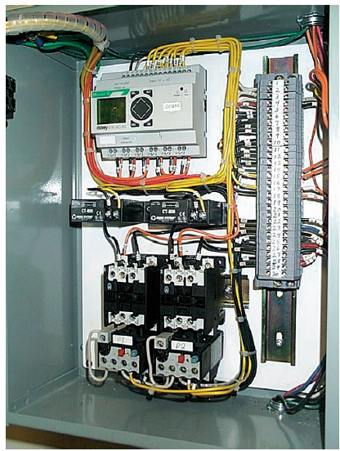
PLC Advantage
PLC
control
panel
Relay
control
panel
Originally, to replace hardwired control relay

Slide 4
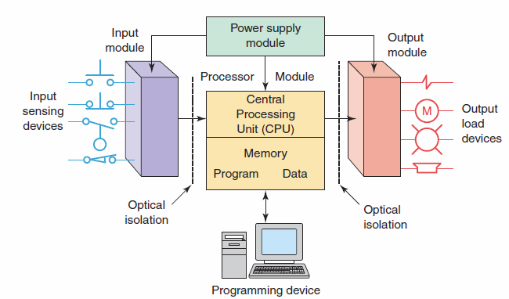
PLC System
Consists of: CPU, I/O section, power supply, and a programming device.

Slide 5
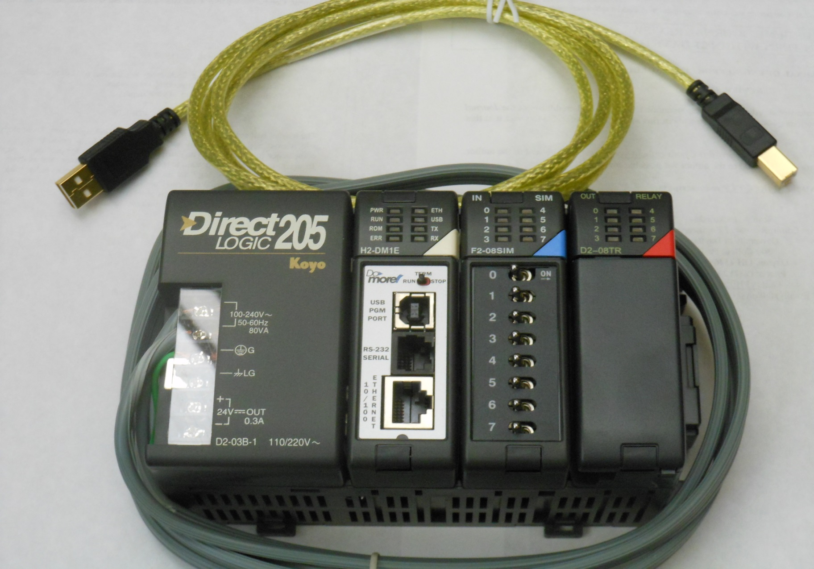
PLC System
Input
Module
CPU
Output
Module
Power
Supply

Slide 6
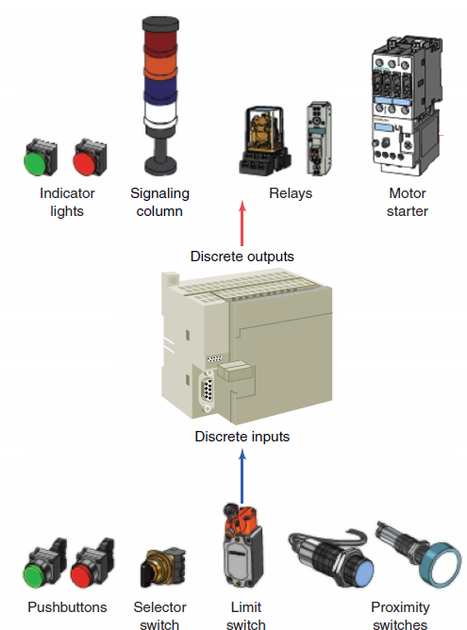
Discrete/Analog I/Os
Discrete:
Devices with on/off nature.
Have only two states: On & Off
Tied to discrete I/O modules.
Analog:
Devices with a range of values.
Tied to analog I/O modules.

Slide 7
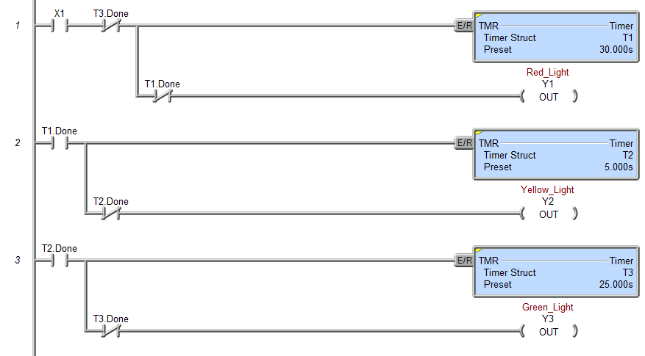
PLC Programming
Software on a PC
Languages
Ladder Diagram (LD)
Function Block Diagram (FBD)
Sequential Flow Chart (SFC)
Structured Text (ST)
Ladder Diagram

Slide 8
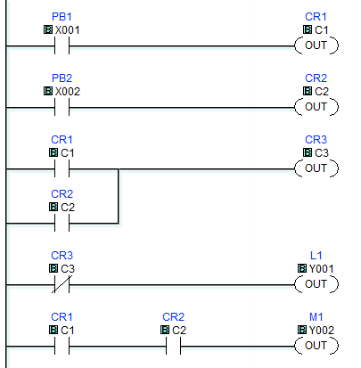
PLC Programming
Ladder Diagram
Software on a PC
Languages
Ladder Diagram (LD)
Function Block Diagram (FBD)
Sequential Flow Chart (SFC)
Structured Text (ST)

Slide 9
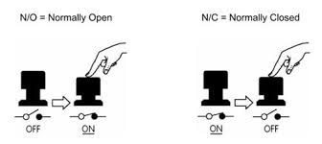

Contacts/Instructions
Contacts
Normally Open (NO)
Normally Closed (NC)
Instructions
Examine ON or Examine if Closed (XIC)
Examine OFF or Examine if Open (XIO)
Not fully interchangeable
Not always
XIC
XIO

Slide 10
PLC Companies
Rockwell (Allen Bradley) – most in US
Siemens – most in Europe
Omron
ABB
Schneider (Modicon)
Mitsubishi - UK
GE
Bosch Rexroth
Beckhoff
Fuji
Toshiba
(Koyo) Automation Direct - Cheapest

Slide 11
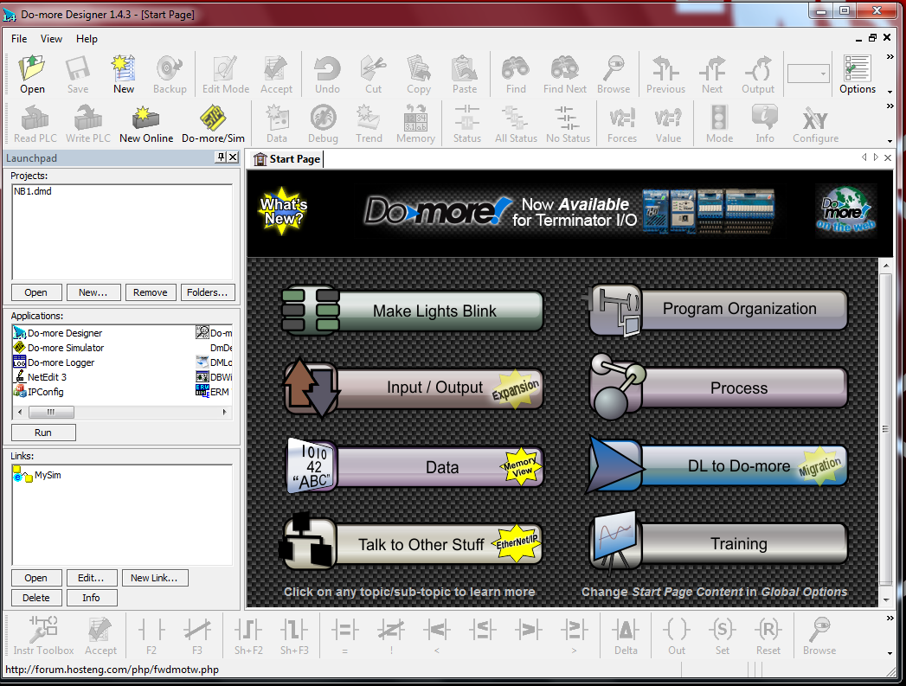
Do-More Designer
Contacts
Normally Open (NO)
Normally Closed (NC)
Instructions
Examine ON or Examine if Closed (XIC)
Examine OFF or Examine if Open (XIO)
Not fully interchangeable

Slide 12
Do-More Designer
https://www.youtube.com/watch?v=jUugb68K41Q
Steps
Create a new program
Make changes
Accept changes
Connect to PLC
Test the program

Slide 13
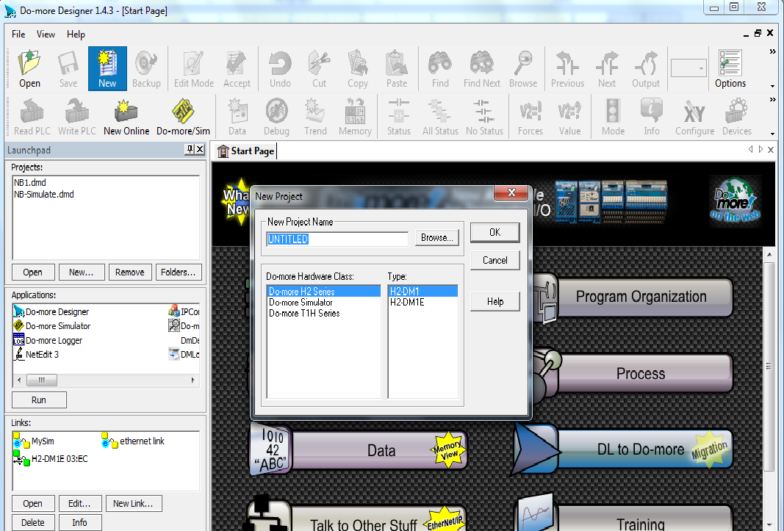
Do-More Designer Cont…
Project Name
Type
Hardware

Slide 14
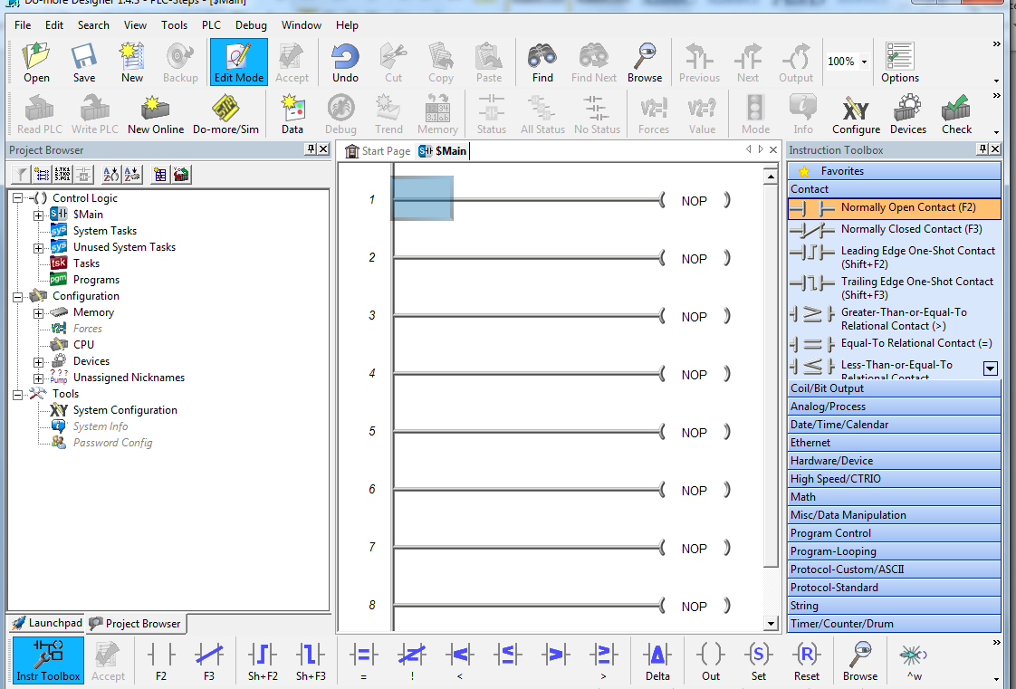
Commands
Write PLC
Accept
Status
PLC Mode
Edit Mode
Rung 1
Instructions

Slide 15
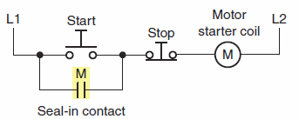
Ex1: Seal-in Circuit
A method of maintaining current flow after a momentary switch has been pressed and released.
Start: Normally Open (NO)
Stop: Normally Closed (NC)
Hardwired

Slide 16
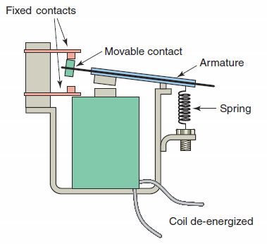
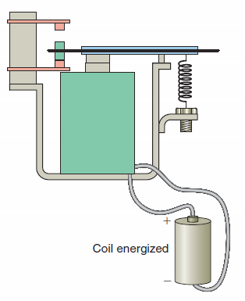
Control Relay
Consists of coil and contacts (NO and/or NC)
Other forms: Contactors, Motor starters, Relays
De-energized
Energized

Slide 17
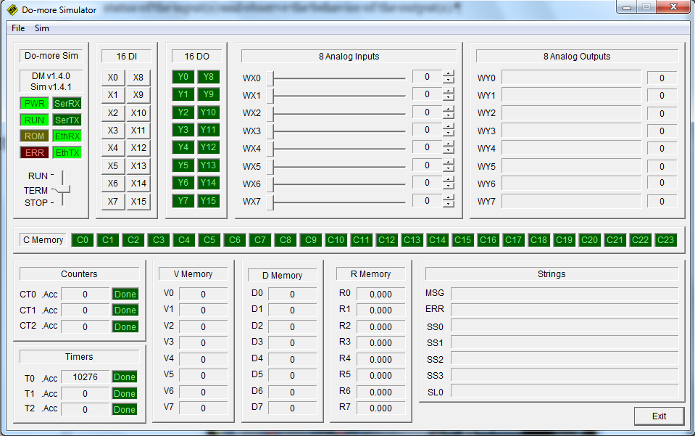
Do-more Simulator
A PLC in the software
Behavior: Like an actual hardware
Suitable for testing and teaching purposes

Slide 18
HMI-Human Machine Interface
Other names:
Man machine Interface (MMI), operator interface, touch screen
Characteristics:
Control and manage an entire line from a single location (screen)
No need to walk to devices to activate/de-activate (time and effort saved)
Replacing hardwired pushbuttons and pilot lights by icons
Buttons are activated by touching corresponding icons
Displaying the operation in graphic format for easier viewing and in real time
Changing the preset values for counters/timers using numeric keypad graphic on the screen
Complete list of alarms with time and of occurrence and location
Displaying variables as they change over time

